Slide 1

Deployment Best Practices
Logic Apps & Azure Functions

Slide 2
Presenter
Alessandro Moura
Lead Integration Consultant
Theta
alessandro.moura@theta.co.nz
www.alessandromoura.com.br
@alessandromoura
Notes:
Briefly introduce yourself
Integration developer since 2003
BizTalk developer since 2006
Working with Logic Apps and Functions for 1.5 year
From Brazil worked in US and now is here in NZ

Slide 3
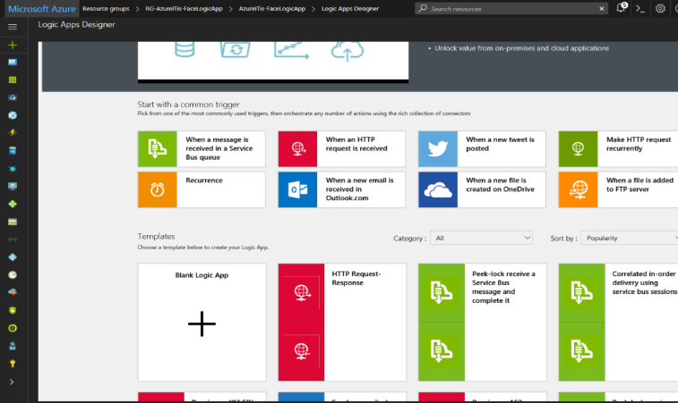
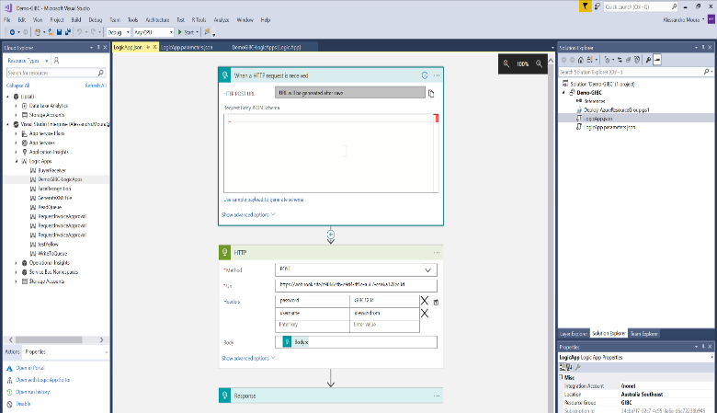
Logic Apps Development Options
Browser
Visual Studio
Notes:
Show the two options to develop with a designer for Logic Apps

Slide 4
Demo – Logic Apps Development
Develop Logic App in the browser
Moving to Visual Studio
Notes:
Start the development in the browser
Create a resource group in the Azure subscription chosen
Create a new Logic App that will call an http endpoint
Create the http endpoint or use an existing one on webhook.site
Call the webhook.site from postman
Developt the call to the webhook from Logic Apps
Call the Logic App from postman
Change the Logic App to pass username and password as headers in the http call
Check the webhook call to show that those parameters were sent

Slide 5
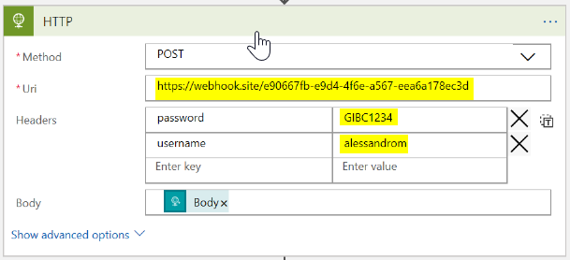
Moving the Logic App to other environments
Notes:
How to deal with these configurations that will change between environments

Slide 6
Demo – Logic Apps Parameters Files
Configure parameters in the Logic App
Create a parameter file per environment
Deploy to each environment
Use Azure Vault to store credentials

Slide 7
Logic Apps – Deployment Options
Visual Studio
Powershell and ARM Template
CI/CD

Slide 8
Azure Functions – Development Options
Browser
Visual Studio
Slots
Demo

Slide 9
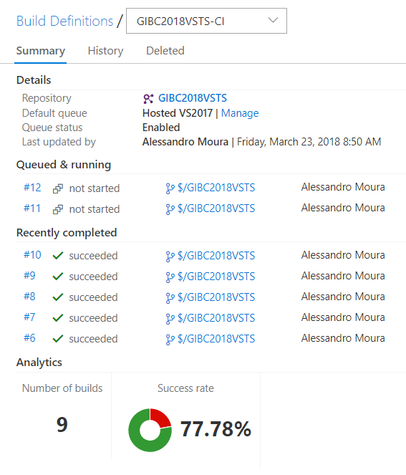
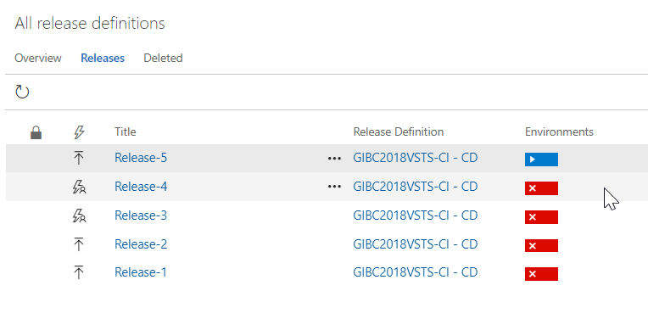
Demo - Logic Apps CI/CD with VSTS

Slide 10
Monitoring
Creating Dashboard
Log Analytics (OMS)
Application Insights

Slide 11



Thank You!!!

Slide 12
Reference material
Johan Hedberg
http://www.integrationusergroup.com/continuous-integration-logic-apps-using-team-foundation-team-services/
ALM Rangers
https://blogs.msdn.microsoft.com/visualstudioalmrangers/2017/10/04/azure-function-ci-cd-devops-pipeline/
Jeff Holan
https://github.com/jeffhollan/LogicAppTemplateCreator
Wagner Silveira
http://notetoself.tech/2017/08/27/rethinking-and-old-logic-app-deployment-package-part-iii/

